Slide 1
Task
-vishnu vardhan tunuguntla

Slide 2
Project Workflow
Task Overview
Tech Stack
Backend Requirements
Database Creation
Backend Implementation & Database Integration
Frontend Requirements
Frontend Implementation
Final Output

Slide 3
Task Overview
Create 50 records in database with the following column fields “sno, customer name, age, phone, location, created_at” and dummy data
Create a single page application to display the above data in table format with search option, and pagination with 20 records per page.
The created_at column data has to be displayed in two separate columns as “date” and “time”
The search functionality will search the data by the column "name" or "location".
There should be an option to sort the data either by "date" or by "time".

Slide 4




Tech Stack
Backend
Frontend
Database

Slide 5
Backend Requirements
Commands To Download Libraries
---npm init –y (Intialize the node modules and package.json files)
--- npm install express cors pg (cors is used for the cross origin request)
--- npm install nodemon –D (dev dependency) (auto save the data in server side)

Slide 6
Database Creation
Create a Table of Customer_details
CREATE TABLE cust_details (
sno SERIAL PRIMARY KEY,
cust_name VARCHAR(100),
age INT,
phone VARCHAR(20),
locations VARCHAR(100),
created_at TIMESTAMP,
dates DATE,
times TIME
);
Insert the values

Slide 7
Backend Implementation & Database Integration
Importing the libraries
const express = require('express');
const cors = require('cors');
const { Pool } = require('pg’);
Database Details
const pool = new Pool({
user: 'postgres’,
host: 'localhost',
database: 'Zithara_Task',
password: '123',
port: 5432,
});

Slide 8
Frontend Requirements
Create a react app
---- npx create-react-app frontend
Install Required Libraries
npm install axios react-data-table-component
Importing libraries
import React, { useState, useEffect } from 'react';
import axios from 'axios';

Slide 9
Table Creation (2 Methods)
I have Created Table in ways:-
Custom table by using html tags
Creating by react-data-table-component

Slide 10
Frontend Implementation
Fetches customer details from the backend using Axios
const fetchCustomers = async () => {
try {
const response = await axios.get('http://localhost:4000/api/customer_details');
setData(response.data);
} catch (error) {
console.error('Error fetching customers:', error);
}
};

Slide 11
Table Actions
Search the data by the column "name" or "location".
Sort the data either by "date" or by "time". (Asc or Des)
Pagination with 20 records per page.

Slide 12
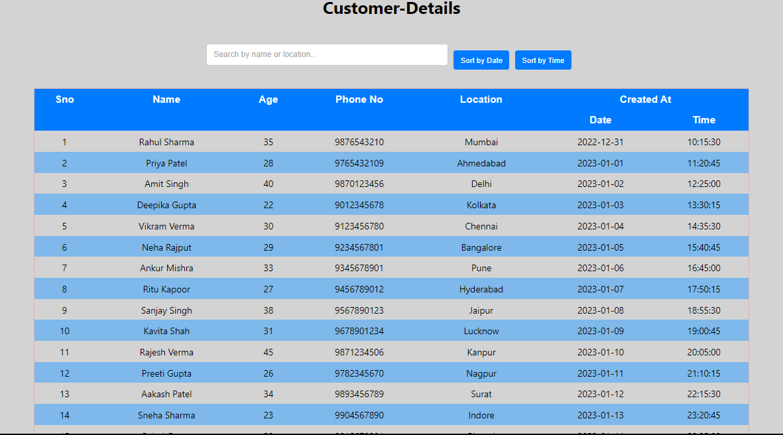
Final Output (By using Custom table)

Slide 13
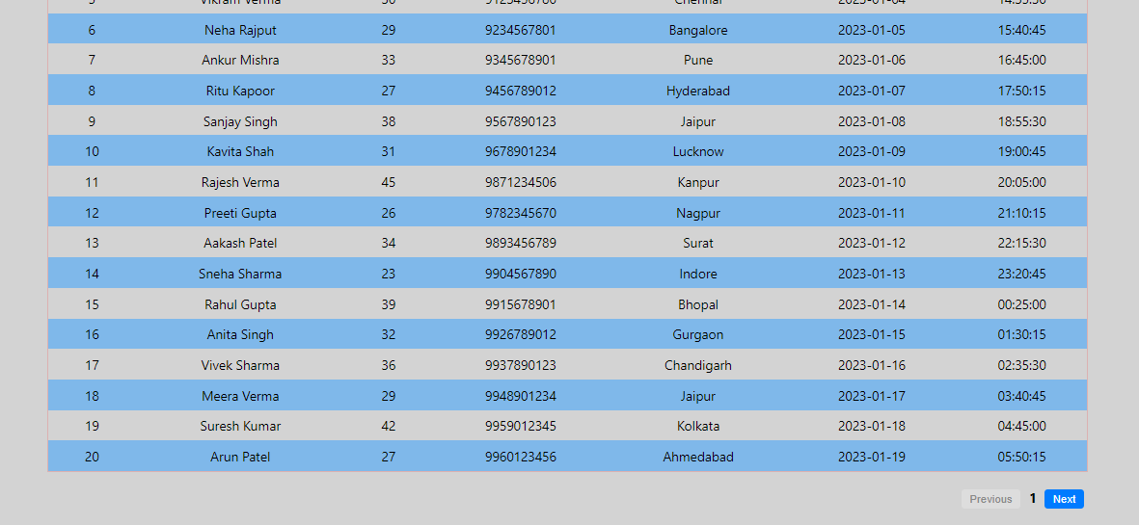

Slide 14
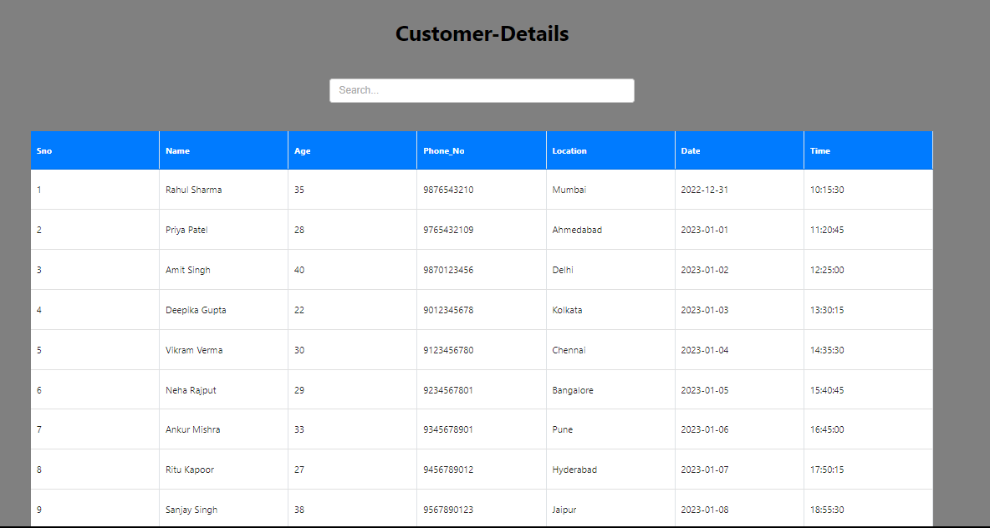
Final Output (By using react-data-table-component)

Slide 15
